Slide 1
Murach’s ASP.NET Core MVC (2nd Ed.)
Chapter 15
How to work with tag helpers, partial views, and view components

Slide 2
Objectives (part 1)
Applied
Reduce code duplication in the views of a web app by creating custom tag helpers, partial views, and view components.
Knowledge
Distinguish between tag helper attributes and elements.
Explain how to register tag helpers.
Explain how to create custom tag helpers for standard and non-standard HTML elements.
Describe the use of the HtmlTarget attribute to control the scope of a tag helper.
Describe the use of the TagHelperOutput class and the TagBuilder class to add an HTML element before or after the tag helper element.
Describe the use of properties within a tag helper class.

Slide 3
Objectives (part 2)
Describe the use of the ViewContext object with a tag helper.
Describe the use of dependency injection with a tag helper.
Describe the use of the SuppressOutput() method of the TagHelperOutput class to create tag helpers that send an element to the browser only under certain conditions.
Describe the use of the GetPathByAction() method of the LinkGenerator class to generate a route-based URL.
Describe what a partial view typically contains.
List and describe the paths that MVC searches for a partial view.
Describe how to use the partial tag helper to include a partial view and pass a model to it.
Distinguish between a partial view and a view component.
Describe how a view component works and how data can be passed to it.

Slide 4
Common built-in tag helpers
asp-action
asp-controller
asp-area
asp-for
asp-validation-summary
asp-validation-for
environment
partial

Slide 5
A tag helper that generates attributes for an <input> tag
<input asp-for="FirstName" class="form-control" />
The HTML that’s sent to the browser
<input class="form-control" type="text" data-val="true" data-val-maxlength="The field FirstName must be a string or array type with a maximum length of &#x27;200&#x27;." data-val-maxlength-max="200" data-val-required="Please enter a first name." id="FirstName" maxlength="200" name="FirstName" value="" />

Slide 6
A tag helper that generates a route-based URL in a <form> tag
<form asp-action="Add" method="post"></form>
The HTML that’s sent to the browser
<form action="/author/add" method="post"></form>

Slide 7
Tag helpers that output a different CSS link based on hosting environment
<environment include="Development">
<link rel="stylesheet"
href="~/lib/bootstrap/css/bootstrap.css" />
</environment>
<environment exclude="Development">
<link rel="stylesheet"
href="~/lib/bootstrap/css/bootstrap.min.css" />
</environment>

Slide 8
A _ViewImports.cshtml file that registers all built-in and custom tag helpers
...
@addTagHelper *, Microsoft.AspNetCore.Mvc.TagHelpers
@addTagHelper *, Bookstore

Slide 9
The using directive for the TagHelpers namespace
using Microsoft.AspNetCore.Razor.TagHelpers;
One virtual method of the TagHelper class
Process(ctx, out)
One property of the TagHelperOutput class
Attributes
One method of the TagHelperAttributeList class
SetAttribute(name, val)

Slide 10
A tag helper that applies to any standard HTML <button> element
public class ButtonTagHelper : TagHelper
{
public override void Process(TagHelperContext context,
TagHelperOutput output)
{
output.Attributes.SetAttribute(
"class", "btn btn-primary");
}
}
Two button elements in a view
<button type="submit">Submit</button>
<button type="reset">Reset Form</button>
The HTML that MVC sends to the browser
<button type="submit" class="btn btn-primary">Submit</button>
<button type="reset" class="btn btn-primary">Reset Form</button>

Slide 11
More properties of the TagHelperOutput class
TagName
TagMode

Slide 12
A tag helper that applies to any non-standard <submit-button> element
public class SubmitButtonTagHelper : TagHelper
{
public override void Process(TagHelperContext context,
TagHelperOutput output)
{
// make it a button element with start and end tags
output.TagName = "button";
output.TagMode = TagMode.StartTagAndEndTag;
// make it a submit button
output.Attributes.SetAttribute("type", "submit");
// append bootstrap button classes
string newClasses = "btn btn-primary";
string oldClasses =
output.Attributes["class"]?.Value.ToString() ?? "";
string classes = (string.IsNullOrEmpty(oldClasses)) ?
newClasses : $"{oldClasses} {newClasses}";
output.Attributes.SetAttribute("class", classes);
}
}

Slide 13
A submit-button element in a view
<submit-button class="me-2">Submit</submit-button>
The HTML that MVC sends to the browser
<button type="submit" class="me-2 btn btn-primary">
Submit</button>

Slide 14
Three extension methods for tag helpers (part 1)
using Microsoft.AspNetCore.Razor.TagHelpers;
...
public static class TagHelperExtensions
{
public static void AppendCssClass(
this TagHelperAttributeList list, string newCssClasses)
{
string oldCssClasses =
list["class"]?.Value.ToString() ?? "";
string cssClasses = (string.IsNullOrEmpty(oldCssClasses)) ?
newCssClasses : $"{oldCssClasses} {newCssClasses}";
list.SetAttribute("class", cssClasses);
}
public static void BuildTag(this TagHelperOutput output,
string tagName, string classNames)
{
output.TagName = tagName;
output.TagMode = TagMode.StartTagAndEndTag;
output.Attributes.AppendCssClass(classNames);
}

Slide 15
Three extension methods for tag helpers (part 2)
public static void BuildLink(this TagHelperOutput output,
string url, string className)
{
output.BuildTag("a", className);
output.Attributes.SetAttribute("href", url);
}
}

Slide 16
Two tag helpers that use the extension methods
public class ButtonTagHelper : TagHelper
{
public override void Process(TagHelperContext context,
TagHelperOutput output)
{
output.Attributes.AppendCssClass("btn btn-primary");
}
}
public class SubmitButtonTagHelper : TagHelper
{
public override void Process(TagHelperContext context,
TagHelperOutput output)
{
output.BuildTag("button", "btn btn-primary");
output.Attributes.SetAttribute("type", "submit");
}
}

Slide 17
Two properties of the HtmlTargetElement attribute
Attributes
ParentTag
Use the HTMLTargetElement attribute to…
Allow a tag helper class to have a different name than the HTML element it targets.
Narrow the scope of a tag helper so it only targets an element under certain conditions.
Widen the scope of a tag helper so it targets multiple elements.

Slide 18
A tag helper for any <label> element
public class LabelTagHelper : TagHelper {...}
Another tag helper for any <label> element
[HtmlTargetElement("label")]
public class MyLabelTagHelper : TagHelper {...}
A tag helper for bound <label> elements in a form
[HtmlTargetElement("label", Attributes = "asp-for",
ParentTag = "form")]
public class FormLabelTagHelper : TagHelper {...}

Slide 19
A tag helper for <input> or <select> elements in a form
[HtmlTargetElement("input", ParentTag = "form")]
[HtmlTargetElement("select", ParentTag = "form")]
public class FormTagHelper : TagHelper {...}

Slide 20
A tag helper for any element of the submit type or any <a> element with a my-button attribute
[HtmlTargetElement(Attributes = "[type=submit]")]
[HtmlTargetElement("a", Attributes = "my-button")]
public class MyButtonTagHelper : TagHelper {...}

Slide 21
Three properties of the TagHelperOutput class
PreElement
Content
PostElement
Two properties of the TagBuilder class
Attributes
InnerHtml
The using directive for the Rendering namespace
using Microsoft.AspNetCore.Mvc.Rendering;
// for TagBuilder

Slide 22
A tag helper that adds a <span> element after the targeted element
[HtmlTargetElement("input", Attributes = "my-required")]
public class RequiredInputTagHelper : TagHelper
{
public override void Process(TagHelperContext context,
TagHelperOutput output)
{
// add CSS class to input element
output.Attributes.AppendCssClass("form-control");
// create a <span> element
TagBuilder span = new TagBuilder("span");
span.Attributes.Add("class","text-danger ms-2");
span.InnerHtml.Append("*");
// add span element after input element
output.PostElement.AppendHtml(span);
}
}

Slide 23
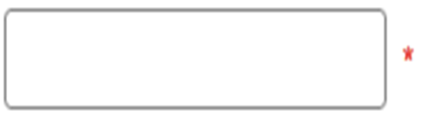
An <input> element that uses the tag helper
<input asp-for="Title" my-required />
The HTML that’s sent to the browser
<input my-required type="text" id="Title" name="Title"
value="" class="form-control" />
<span class="text-danger ms-2">*</span>
The elements displayed in a browser

Slide 24
A tag helper that generates numeric options for a <select> element
[HtmlTargetElement("select",
Attributes = "my-min-number, my-max-number")]
public class NumberDropDownTagHelper : TagHelper
{
[HtmlAttributeName("my-min-number")]
public int Min { get; set; }
[HtmlAttributeName("my-max-number")]
public int Max { get; set; }
public override void Process(TagHelperContext context,
TagHelperOutput output)
{
for (int i = Min; i <= Max; i++)
{
TagBuilder option = new TagBuilder("option");
option.InnerHtml.Append(i.ToString());
output.Content.AppendHtml(option);
}
}
}

Slide 25
A view that uses the tag helper
@model CartItem
...
<select asp-for="Quantity" class="form-select"
my-min-number="1" my-max-number="10"></select>
The HTML that’s sent to the browser
<select class="form-select" id="Quantity" name="Quantity">
<option>1</option>
<option>2</option>
...
<option>10</option>
</select>

Slide 26
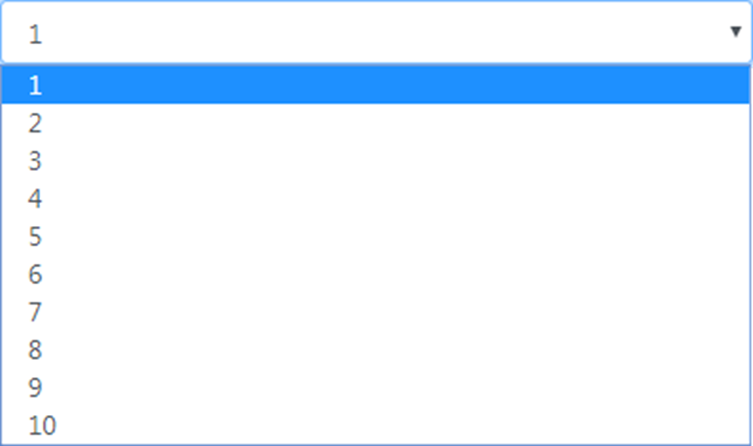
The <select> element displayed in a browser

Slide 27
One property of the TagHelperContext class
AllAttributes
Three properties of the ModelExpression class
Name
Model
Metadata
The using statement for the ViewFeatures namespace
using Microsoft.AspNetCore.Mvc.ViewFeatures;
// for ModelExpression

Slide 28
The updated NumberDropDownTagHelper class
[HtmlTargetElement("select", Attributes = "my-min-number, my-max-number")]
public class NumberDropDownTagHelper : TagHelper
{
// Min and Max properties same as before
public override void Process(TagHelperContext context,
TagHelperOutput output)
{
// get selected value from view's model
ModelExpression aspfor =
(ModelExpression) context.AllAttributes["asp-for"].Value;
int modelValue = (int)aspfor.Model;
for (int i = Min; i <= Max; i++)
{
TagBuilder option = new TagBuilder("option");
option.InnerHtml.Append(i.ToString());
// mark option as selected if matches model's value
if (modelValue == i)
option.Attributes["selected"] = "selected";
output.Content.AppendHtml(option);
}
}
}

Slide 29
A tag helper that gets a ViewContext object (part 1)
using Microsoft.AspNetCore.Mvc.ViewFeatures;
using Microsoft.AspNetCore.Mvc.Rendering;
...
[HtmlTargetElement("a", Attributes = "[class=nav-link]",
ParentTag = "li")]
public class ActiveNavbarTagHelper : TagHelper
{
[ViewContext]
[HtmlAttributeNotBound]
public ViewContext ViewCtx { get; set; } = null!;
public override void Process(TagHelperContext context,
TagHelperOutput output)
{
string area =
ViewCtx.RouteData.Values["area"]?.ToString() ?? "";
string ctlr =
ViewCtx.RouteData.Values["controller"]?.ToString()!;

Slide 30
A tag helper that gets a ViewContext object (part 2)
string aspArea = context.AllAttributes["asp-area"]?.Value?
.ToString() ?? "";
string aspCtlr =
context.AllAttributes["asp-controller"]?.Value?
.ToString()!;
if (area == aspArea && ctlr == aspCtlr)
output.Attributes.AppendCssClass("active");
}
}

Slide 31
A tag helper that gets a Cart object via dependency injection
[HtmlTargetElement("span", Attributes = "my-cart-badge")]
public class CartBadgeTagHelper : TagHelper
{
private ICart cart;
public CartBadgeTagHelper(ICart c) => cart = c;
public bool MyCartBadge { get; set; }
public override void Process(TagHelperContext context,
TagHelperOutput output)
{
output.Content.SetContent(cart.Count?.ToString());
}
}
The tag helper in a layout
<span class="fas fa-shopping-cart"></span>&nbsp;Cart
<span class="badge bg-light text-dark" my-cart-badge></span>

Slide 32
A layout that only displays an element if there’s a value in TempData
<main>
@if (TempData.ContainsKey("message"))
{
<h4 class="bg-info text-center text-white p-2">
@TempData["message"]
</h4>
}
@RenderBody()
</main>

Slide 33
A method of the TagHelperOutput class
SuppressOutput()

Slide 34
A tag helper that only outputs HTML if there’s a value in TempData
using Microsoft.AspNetCore.Mvc.ViewFeatures; // ViewContext attribute
using Microsoft.AspNetCore.Mvc.Rendering; // ViewContext data type
...
[HtmlTargetElement("my-temp-message")]
public class TempMessageTagHelper : TagHelper
{
[ViewContext]
[HtmlAttributeNotBound]
public ViewContext ViewCtx { get; set; } = null!;
public override void Process(TagHelperContext context,
TagHelperOutput output)
{
var td = ViewCtx.TempData;
if (td.ContainsKey("message"))
{
output.BuildTag("h4", "bg-info text-center text-white p-2");
output.Content.SetContent(td["message"].ToString());
}
else
{
output.SuppressOutput();
}
}
}

Slide 35
A layout that uses the conditional tag helper
<main>
<my-temp-message />
@RenderBody()
</main>

Slide 36
A tag helper that generates a paging link (part 1)
using Microsoft.AspNetCore.Mvc.ViewFeatures;
using Microsoft.AspNetCore.Mvc.Rendering;
using Bookstore.Models;
...
[HtmlTargetElement("my-paging-link")]
public class PagingLinkTagHelper : TagHelper
{
private LinkGenerator linkBuilder;
public PagingLinkTagHelper(LinkGenerator lg) =>
linkBuilder = lg;
[ViewContext]
[HtmlAttributeNotBound]
public ViewContext ViewCtx { get; set; } = null!;
public int Number { get; set; }
public GridData Current { get; set; } = null!;
public override void Process(TagHelperContext context,
TagHelperOutput output)
{
// update routes for this paging link
var routes = Current.Clone();
routes.PageNumber = Number;

Slide 37
A tag helper that generates a paging link (part 2)
// get controller and action method, create paging link URL
string ctlr = ViewCtx.RouteData.
Values["controller"]?.ToString() ?? "";
string action = ViewCtx.RouteData.
Values["action"]?.ToString() ?? "";
string url = linkBuilder.GetPathByAction(
action, ctlr, routes.ToDictionary()) ?? "";
// build up CSS string
string linkClasses = "btn btn-outline-primary";
if (Number == Current.PageNumber)
linkClasses += " active";
output.BuildLink(url, linkClasses);
output.Content.SetContent(Number.ToString());
}
}

Slide 38
A view that uses the tag helper that generates a paging link
@{
for (int i = 1; i <= Model.TotalPages; i++) {
<my-paging-link number="@i"
current="@Model.CurrentRoute" />
}
}

Slide 39
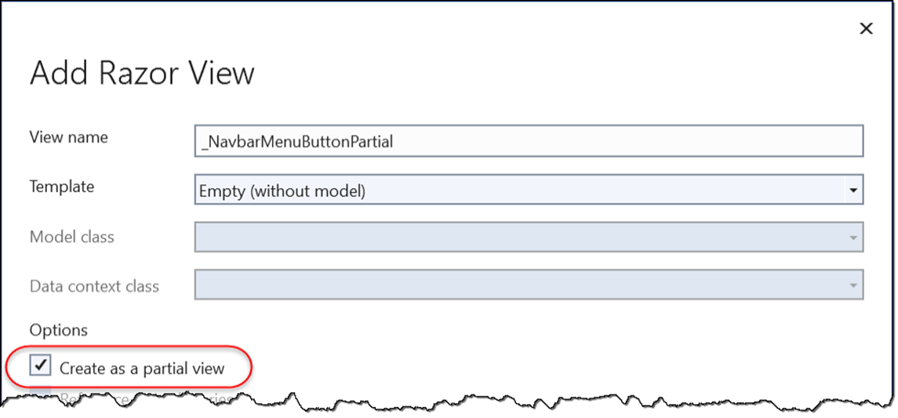
The Add Razor View dialog
How to add a partial view
Right click the desired folder location and select Add→View.
Use the Razor View template and check the Create as a partial view checkbox.

Slide 40
The paths that MVC searches for a partial view
/Views/ControllerName/PartialViewName
/Views/Shared/PartialViewName

Slide 41
A partial view that loads the jQuery validation libraries
<script
src="~/lib/jquery-validation/dist/jquery.validate.min.js">
</script>
<script
src="~/lib/jquery-validation-unobtrusive/ jquery.validate.unobtrusive.min.js">
</script>
A tag helper that includes the partial view in a view
<partial name="_ValidationScriptsPartial" />

Slide 42
A partial view that contains the HTML for a Bootstrap navbar menu button
<button class="navbar-toggler" type="button"
data-bs-toggle="collapse"
data-bs-target="#menu" aria-controls="menu"
aria-expanded="false"
aria-label="Toggle navigation">
<span class="navbar-toggler-icon"></span>
</button>
A layout that uses the partial view in a Bootstrap navbar
<nav class="navbar navbar-expand-md navbar-dark bg-dark">
<partial name="_NavbarMenuButtonPartial" />
<div class="collapse navbar-collapse" id="menu">
<ul class="navbar-nav me-auto">...</ul>
</div>
</nav>

Slide 43
Four attributes of the partial tag helper
name
model
for
viewData

Slide 44
The _BookLinkPartial partial view
@model Book
<a asp-action="Details" asp-controller="Book"
asp-route-id="@Model.BookId"
asp-route-slug="@Model.Title.Slug()">
@Model.Title
</a>

Slide 45
The partial view included in a view with the same model object
The Home/Index view
@model Book
...
<h5>
<partial name="_BookLinkPartial" />
</h5>
...

Slide 46
The partial view included in a view with a different model object
The Book/List view
@model BookListViewModel
...
@foreach (Book book in Model.Books) {
<tr>
<td>
<partial name="_BookLinkPartial" model="@book" />
</td>
...

Slide 47
A method in a ViewComponent class
Invoke([params])
The folder for the view component classes
/Components

Slide 48
A view component that passes the Cart count to a partial view
using Microsoft.AspNetCore.Mvc;
...
public class CartBadge : ViewComponent
{
private ICart cart { get; set; }
public CartBadge(ICart c) => cart = c;
public IViewComponentResult Invoke() =>
View(cart.Count);
}
The Default.cshtml partial view
@model int?
<span class="badge bg-light text-dark">@Model</span>

Slide 49
The paths that MVC searches for a view component’s partial view
/Views/ControllerName/Components/ViewComponentName/ViewName
/Views/Shared/Components/ViewComponentName/ViewName

Slide 50
A layout that uses tag helper syntax to call the view component
<span class="fas fa-shopping-cart"></span>&nbsp;Cart
<vc:cart-badge></vc:cart-badge>

Slide 51
A view component with an Invoke() method that has parameters
public class BookDetailsLink : ViewComponent
{
public IViewComponentResult Invoke(int id, string title)
{
Book book = new Book {
BookId = id,
Title = title
};
return View("~/Views/Shared/_BookLinkPartial.cshtml", book);
}
}

Slide 52
The _BookLinkPartial partial view
@model Book
<a asp-action="Details" asp-controller="Book" asp-area=""
asp-route-id="@Model.BookId"
asp-route-slug="@Model.Title.Slug()">
@Model.Title
</a>

Slide 53
A view that uses the view component
The Cart/Index view
@foreach (CartItem item in Model.List) {
@* use view component rather than partial view here bc
CartItem Book property is type BookDTO, not Book *@
<tr>
<td>
<vc:book-details-link id="@item.Book.BookId"
title="@item.Book.Title"></vc:book-details-link>
</td>
...
}

Slide 54
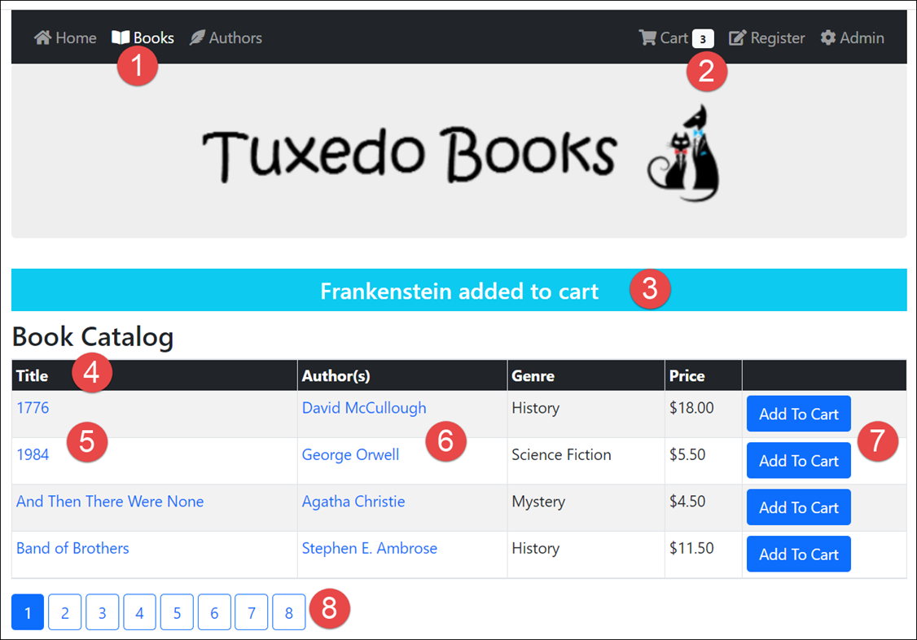
The Book Catalog page

Slide 55
The custom tag helpers, partial views, and view components in this page
The ActiveNavbar tag helper.
The CartBadge view component.
The TempMessage tag helper.
A SortingLink tag helper.
The _BookLink partial view.
An _AuthorLink partial view.
The Button tag helper.
The PagingLink tag helper.

Slide 56
The ActiveNavbar tag helper updated to account for the Admin area (part 1)
[HtmlTargetElement("a", Attributes = "[class=nav-link]",
ParentTag = "li")]
public class ActiveNavbarTagHelper : TagHelper
{
[ViewContext]
[HtmlAttributeNotBound]
public ViewContext ViewCtx { get; set; }
[HtmlAttributeName("my-mark-area-active")]
public bool IsAreaOnly { get; set; }
public override void Process(TagHelperContext context,
TagHelperOutput output)
{
string area = ViewCtx.RouteData.Values["area"]?
.ToString() ?? "";
string ctlr = ViewCtx.RouteData.Values["controller"]
.ToString();

Slide 57
The ActiveNavbar tag helper updated to account for the Admin area (part 2)
string aspArea = context.AllAttributes["asp-area"]?.Value?
.ToString() ?? "";
string aspCtlr = context.AllAttributes["asp-controller"]
.Value.ToString();
if (area == aspArea && ctlr == aspCtlr)
output.Attributes.AppendCssClass("active");
else if (IsAreaOnly && area == aspArea)
output.Attributes.AppendCssClass("active");
}
}

Slide 58
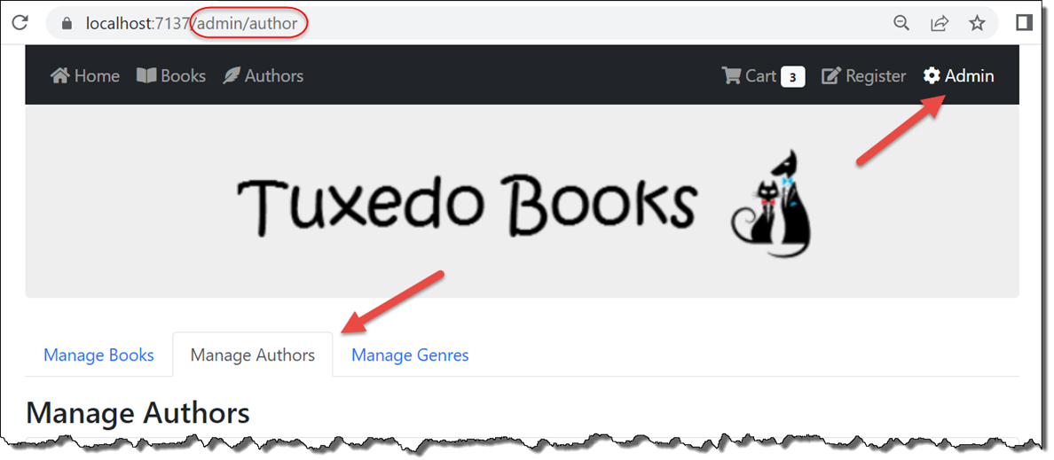
The two active navbar links on the Manage Authors page of the Admin area

Slide 59
The layout of the Bookstore app (part 1)
<!DOCTYPE html>
<html lang="en">
<head>...</head>
<body>
<div class="container">
<nav class="navbar navbar-expand-md navbar-dark bg-dark
ps-3 pe-3">
<partial name="_NavbarMenuButtonPartial" />
<div class="collapse navbar-collapse" id="menu">
<ul class="navbar-nav me-auto">
<li class="nav-item">
<a class="nav-link" asp-action="Index"
asp-controller="Home" asp-area="">
<span class="fas fa-home"></span>
&nbsp;Home
</a>
</li>
@* nav item links for Books and Authors *@
</ul>

Slide 60
The layout of the Bookstore app (part 2)
<ul class="navbar-nav ms-auto">
<li class="nav-item">
<a class="nav-link" asp-action="Index"
asp-controller="Cart" asp-area="">
<span class="fas fa-shopping-cart">
</span>&nbsp;Cart
<vc:cart-badge></vc:cart-badge>
</a>
</li>
@* nav item link for Registration goes here *@
<li class="nav-item">
<a class="nav-link" asp-action="Index"
asp-controller="Book" asp-area="Admin"
my-mark-area-active>
<span class="fas fa-cog"></span>
&nbsp;Admin
</a>
</li>
</ul>
</div>
</nav>

Slide 61
The layout of the Bookstore app (part 3)
<header class="text-center">
<a asp-action="Index" asp-controller="Home">
<img src="~/images/logo.png"
class="img-fluid center-block" />
</a>
</header>
<main>
<my-temp-message />
@RenderBody()
</main>
</div>
<script src="~/lib/jquery/dist/jquery.min.js"></script>
<script src="~/lib/bootstrap/dist/js/bootstrap.bundle.min.js">
</script>
<script src="~/js/site.js" asp-append-version="true"></script>
@RenderSection("Scripts", required: false)
</body>
</html>

Slide 62
The Book/List view (part 1)
@model BookListViewModel
...
@* add to cart form *@
<form asp-action="Add" asp-controller="Cart" method="post">
<table class="table table-bordered table-striped table-sm">
<thead class="bg-dark text-white">
<tr>
<th>
<my-sorting-link sort-field="Title"
current="@Model.CurrentRoute">
Title</my-sorting-link></th>
<th>Author(s)</th>
<th>
<my-sorting-link sort-field="Genre"
current="@Model.CurrentRoute">
Genre</my-sorting-link></th>
<th>
<my-sorting-link sort-field="Price"
current="@Model.CurrentRoute">
Price</my-sorting-link></th>
<th></th>
</tr>
</thead>

Slide 63
The Book/List view (part 2)
<tbody>
@foreach (Book book in Model.Books) {
<tr>
<td><partial name="_BookLinkPartial"
model="@book" /></td>
<td>
@foreach (var author in book.Authors) {
<p><partial name="_AuthorLinkPartial"
model="@author" /></p>
}
</td>
<td>@book.Genre?.Name</td>
<td>@book.Price.ToString("c")</td>
<td><button type="submit" name="id"
value="@book.BookId">
Add To Cart</button></td>
</tr>
}
</tbody>
</table>
</form>

Slide 64
The Book/List view (part 3)
@{
for (int i = 1; i <= Model.TotalPages; i++) {
<my-paging-link number="@i" current="@Model.CurrentRoute" />
}
}

